Slide 1
EQUATION SOLVER GAME
M. PRIYADARSHINI
Submission Date: 26.09.2024

Slide 2

Aim of the
Project
The program aims to help users practice math skills by solving randomly generated equations. It provides instant feedback and tracks the time taken to complete the quiz.

Slide 3
Problem Statement
Problem:
Solution:
Many students find traditional math exercises dull and repetitive, which can lead to disengagement and difficulty improving their skills.
This program turns basic arithmetic practice into a fun game by generating random math problems, offering real-time feedback, and tracking completion time. It ensures users stay engaged while improving their math skills.

Slide 4

Project Description
Objectives:
Technologies Used:
Provide a fun and interactive way to practice arithmetic.
Python
Random Module
Time Module
Error Handling
Improve problem-solving skills through random question generation.
Deliver immediate feedback to enhance learning.
Track the time taken to complete a set of problems, adding a competitive element.

Slide 5
01
Random Math Problems
The program generates random math questions using addition, subtraction, and multiplication.
02
User Input
It prompts the user to solve each problem by entering their answer.
Main Functionalities
03
Error Handling
If the user enters a non-numeric value, the program asks them to try again.
04
Real-time Feedback
The program checks if the user's answer is correct and provides immediate feedback.
05
Time Tracking
It tracks how long the user takes to complete the entire quiz and displays the total time at the end.

Slide 6
Error and Exception Handling
Try Block
Except Block
The program asks the user for input and attempts to convert it to a float
If the input is invalid, the ValueError is caught, and the program shows a message ("Invalid input! Please enter a valid number.") without crashing. It then prompts the user to try again until a valid number is entered.

Slide 7
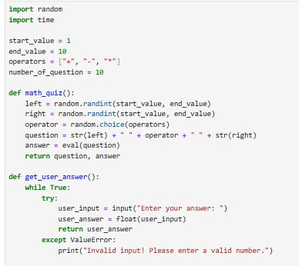
Code Implementation
The program generates random math questions and asks the user to solve them.

Slide 8
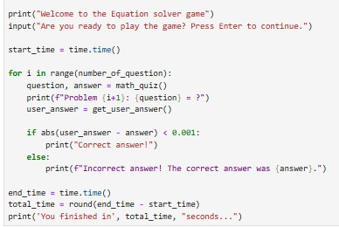
It handles invalid inputs and provides feedback on correct or incorrect answers.
The total time to solve all problems is displayed at the end, adding a challenge element.

Slide 9
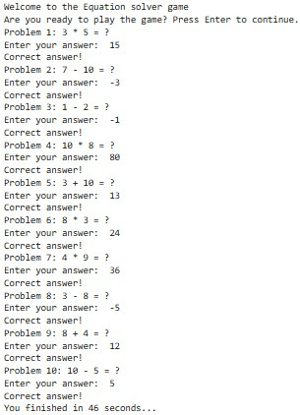
Result

Slide 10

The Equation Solver Game is a fun and interactive way for users to practice math. It gives random math problems, checks answers right away, and helps users correct mistakes without stopping the game. This makes learning math enjoyable and easy, allowing users to improve their skills while playing.
Conclusion
Future Development
Data Analytics
Difficulty Level
Visual Representation

